Slide 1
Module 01
Introduction to Software Engineering

Slide 2
Outline
Nature of Software, Software Engineering, Software Process, Capability Maturity Model (CMM) Generic Process Model, Prescriptive Process Models: The Waterfall Model, V-model, Incremental Process Models, Evolutionary Process Models, Concurrent Models, Agile process, Agility Principles, Extreme Programming (XP), Scrum, Kanban model
Self-learning Topics: Personal and Team Process Models

Slide 3
Software
What is software?
Computer programs and associated documentation. Software products may be developed for a particular customer or may be developed for a general market.
Software is: (1) instructions (computer programs) that when executed provide desired features, function, and performance; (2) data structures that enable the programs to adequately manipulate information and (3) documentation that describes the operation and use of the programs.
What are the attributes of good software?
Good software should deliver the required functionality and performance to the user and should be maintainable, dependable and usable.

Slide 4
Software Applications
system software
application software
engineering/scientific software
embedded software
product-line software
WebApps (Web applications)
AI software

Slide 5
Essential attributes of good software
Maintainability
Software should be written in such a way so that it can evolve to meet the changing needs of customers. This is a critical attribute because software change is an inevitable requirement of a changing business environment.
Dependability and security
Software dependability includes a range of characteristics including reliability, security and safety. Dependable software should not cause physical or economic damage in the event of system failure. Malicious users should not be able to access or damage the system.

Slide 6
Essential attributes of good software
Efficiency
Software should not make wasteful use of system resources such as memory and processor cycles. Efficiency therefore includes responsiveness, processing time, memory utilisation, etc.
Acceptability
Software must be acceptable to the type of users for which it is designed. This means that it must be understandable, usable and compatible with other systems that they use.

Slide 7
Software Engineering
Software engineering is an engineering discipline that is concerned with all aspects of software production from the early stages of system specification through to maintaining the system after it has gone into use.
Engineering discipline
  Using appropriate theories and methods to solve problems bearing in mind organizational and financial constraints.
All aspects of software production
  Not just technical process of development. Also project management and the development of tools, methods etc. to support software production.

Slide 8
Software Engineering
The IEEE definition:
  Software Engineering: (1) The application of a systematic, disciplined, quantifiable approach to the development, operation, and maintenance of software; that is, the application of engineering to software. (2) The study of approaches as in (1).

Slide 9
What is a Software Process?
A set of activities, methods, practices, and transformations that people use to develop and maintain software and the associated products (e.g., project plans, design documents, code, test cases, and user manuals)
As an organization matures, the software process becomes better defined and more consistently implemented throughout the organization
Software process maturity is the extent to which a specific process is explicitly defined, managed, measured, controlled, and effective

Slide 10
A Layered Technology
tools
methods
process model
a “quality” focus
Software Engineering

Slide 11
A Process framework
A process framework establishes the foundation for a complete software process by identifying a small number of framework activities that are applicable to all software projects, regardless of their size or complexity.
In addition, the process framework encompasses a set of umbrella activities that are applicable across the entire software process.

Slide 12

A software process framework

Slide 13
A Process framework
A process framework establishes the foundation for a complete software process by identifying a small number of framework activities that are applicable to all software projects, regardless of their size or complexity.
In addition, the process framework encompasses a set of umbrella activities that are applicable across the entire software process.

Slide 14
Framework Activities
Communication
Planning
Modeling
  Analysis of requirements
  Design
Construction
  Code generation
  Testing
Deployment

Slide 15
Identifying a Task Set
A task set defines the actual work to be done to accomplish the objectives of a software engineering action.
  A list of the task to be accomplished
  A list of the work products to be produced
  A list of the quality assurance filters to be applied

Slide 16
Umbrella Activities
Software project management
Formal technical reviews
Software quality assurance
Software configuration management
Work product preparation and production
Reusability management
Measurement
Risk management

Slide 17
Immature Software Organizations
Software processes are generally improvised
If a process is specified, it is not rigorously followed or enforced
The software organization is reactionary
Managers only focus on solving immediate (crisis) problems
Schedules and budgets are routinely exceeded because they are not based on realistic estimates
When hard deadlines are imposed, product functionality and quality are often compromised
There is no basis for judging process quality or for solving product or process problems
Activities such as reviews and testing are curtailed or eliminated when projects fall behind schedule

Slide 18
Capability Maturity Model (CMM)
The Software Engineering Institute (SEI) has a way to assess how mature an organization's process is.
To determine an organizations current state of process maturity , SEI uses an assessment that results in a five-point grading scheme.
Grading scheme determines compliance with CMM that defines key activities required at different levels.
SEI approach provides a measure of global effectiveness of a company’s s/w engg practices & establishes five process maturity levels that are defined as:
Initial Level (Level 1)
Repeatable (Level 2)
Defined (Level 3)
Managed (Level 4)
Optimized (Level 5)

Slide 19
The SEI capability maturity model
  Capability Maturity Model (CMM) introduced in the early 1990s.
Initial
  Essentially uncontrolled
Repeatable
  Product management procedures defined and used
Defined
  Process management procedures and strategies defined
  and used
Managed
  Quality management strategies defined and used
Optimising
  Process improvement strategies defined and used

Slide 20
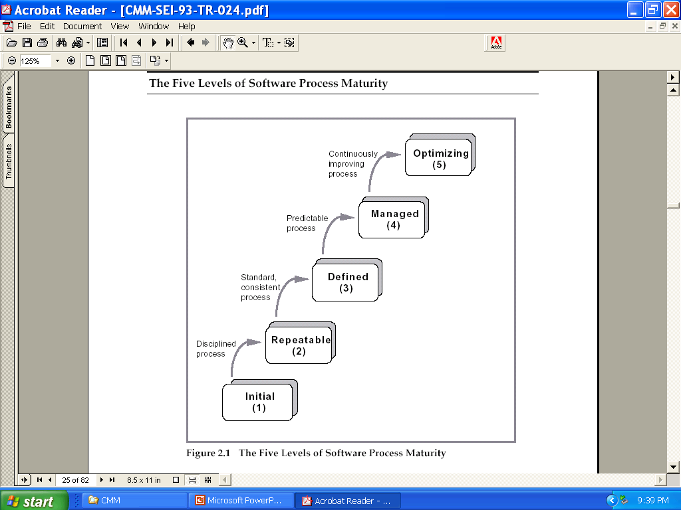
Five Levels of Software Process Maturity

Slide 21
Characteristics of Each Level
Initial Level (Level 1)
  Characterized as ad hoc, and occasionally even chaotic
  Few processes are defined, and success depends on individual effort
Repeatable (Level 2)
  Basic project management processes are established to track cost, schedule, and functionality
  The necessary process discipline is in place to repeat earlier successes on projects with similar applications

Slide 22
Characteristics of Each Level
Defined (Level 3)
  The software process for both management and engineering activities is documented, standardized, and integrated into a standard software process for the organization
  All projects use an approved, tailored version of the organization's standard software process for developing and maintaining software
Managed (Level 4)
  Detailed measures of the software process and product quality are collected
  Both the software process and products are quantitatively understood and controlled
Optimized (Level 5)
  Continuous process improvement is enabled by quantitative feedback from the process and from piloting innovative ideas and technologies

Slide 23
Key Process Areas (KPAs)
SEI has associated KPAs with each maturity level.
KPAs describes s/w engg functions that must be present to satisfy good practice at a particular level
The Following KPAs should be achieved at each process maturity level

Slide 24
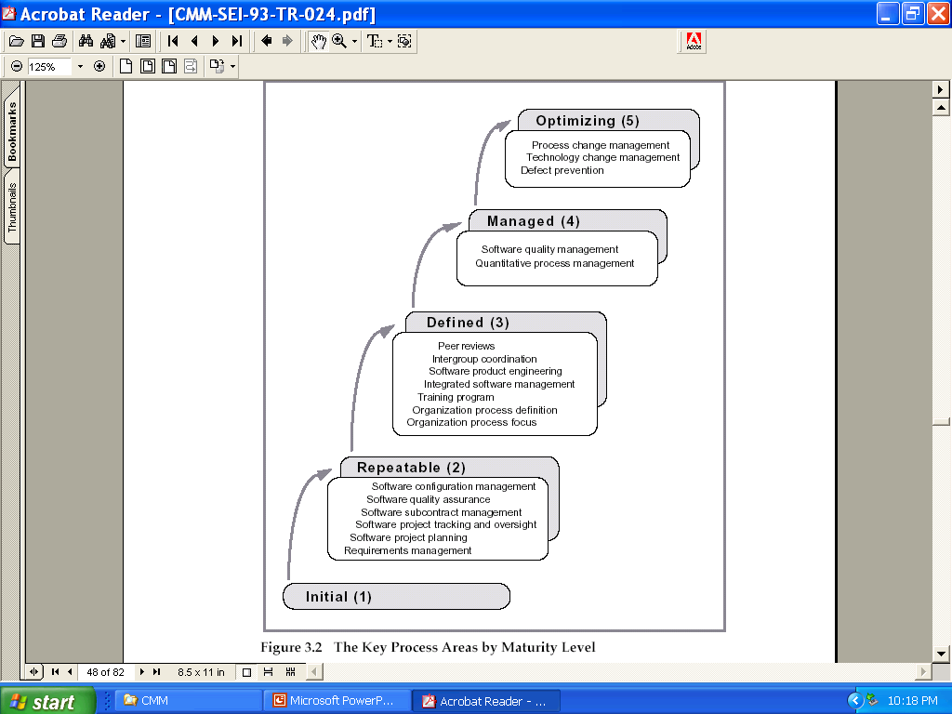
Key Process Areas

Slide 25
The CMMI model
  Revised maturity framework (CMMI) introduced in 2001.
An integrated capability model that includes software and systems engineering capability assessment.
The model has two instantiations
  Staged where the model is expressed in terms of capability levels;
  Continuous where a capability rating is computed.

Slide 26
The CMMI model
An integrated capability model that includes software and systems engineering capability assessment.
The model has two instantiations
  Staged where the model is expressed in terms of capability levels;
  Continuous where a capability rating is computed.

Slide 27
CMMI assessment
Examines the processes used in an organisation and assesses their maturity in each process area.
Based on following scale:
  Initial;
  Managed;
  Defined;
  Quantitatively managed;
  Optimizing.

Slide 28
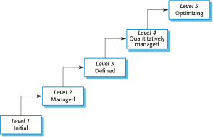
The CMMI staged maturity model

Slide 29
The continuous CMMI model
This is a finer-grain model that considers individual or groups of practices and assesses their use.
The maturity assessment is not a single value but is a set of values showing the organisations maturity in each area.
The CMMI rates each process area from levels 1 to 5.
The advantage of a continuous approach is that organisations can pick and choose process areas to improve according to their local needs.

Slide 30
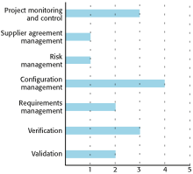
A process capability profile

Slide 31
Process Patterns
A process pattern
  describes a process-related problem that is encountered during software engineering work,
  identifies the environment in which the problem has been encountered, and
  suggests one or more proven solutions to the problem.
Stated in more general terms, a process pattern provides you with a template [Amb98]—a consistent method for describing problem solutions within the context of the software process.

Slide 32
Process Pattern Types
Stage patterns—defines a problem associated with a framework activity for the process.
Task patterns—defines a problem associated with a software engineering action or work task and relevant to successful software engineering practice
Phase patterns—define the sequence of framework activities that occur with the process, even when the overall flow of activities is iterative in nature.

Slide 33
Process Assessment and Improvement
Standard CMMI Assessment Method for Process Improvement (SCAMPI) — provides a five step process assessment model that incorporates five phases: initiating, diagnosing, establishing, acting and learning.
CMM-Based Appraisal for Internal Process Improvement (CBA IPI)—provides a diagnostic technique for assessing the relative maturity of a software organization; uses the SEI CMM as the basis for the assessment [Dun01]
SPICE—The SPICE (ISO/IEC15504) standard defines a set of requirements for software process assessment. The intent of the standard is to assist organizations in developing an objective evaluation of the efficacy of any defined software process. [ISO08]
ISO 9001:2000 for Software—a generic standard that applies to any organization that wants to improve the overall quality of the products, systems, or services that it provides. Therefore, the standard is directly applicable to software organizations and companies. [Ant06]

Slide 34
Personal Software Process (PSP)
Planning. This activity isolates requirements and develops both size and resource estimates. In addition, a defect estimate (the number of defects projected for the work) is made. All metrics are recorded on worksheets or templates. Finally, development tasks are identified and a project schedule is created.
High-level design. External specifications for each component to be constructed are developed and a component design is created. Prototypes are built when uncertainty exists. All issues are recorded and tracked.
High-level design review. Formal verification methods (Chapter 21) are applied to uncover errors in the design. Metrics are maintained for all important tasks and work results.
Development. The component level design is refined and reviewed. Code is generated, reviewed, compiled, and tested. Metrics are maintained for all important tasks and work results.
Postmortem. Using the measures and metrics collected (this is a substantial amount of data that should be analyzed statistically), the effectiveness of the process is determined. Measures and metrics should provide guidance for modifying the process to improve its effectiveness.

Slide 35
Team Software Process (TSP)
Build self-directed teams that plan and track their work, establish goals, and own their processes and plans. These can be pure software teams or integrated product teams (IPT) of three to about 20 engineers.
Show managers how to coach and motivate their teams and how to help them sustain peak performance.
Accelerate software process improvement by making CMM Level 5 behavior normal and expected.
  The Capability Maturity Model (CMM), a measure of the effectiveness of a software process, is discussed in Chapter 30.
Provide improvement guidance to high-maturity organizations.
Facilitate university teaching of industrial-grade team skills.

